Slide 1
Solving System of Linear Equations
Hung-yi Lee
Notes:
http://www.mathconcentration.com/profiles/blogs/real-world-application-of-solving-equations
Examples

Slide 2
Reference
Textbook: Chapter 1.3, 1.4

Slide 3
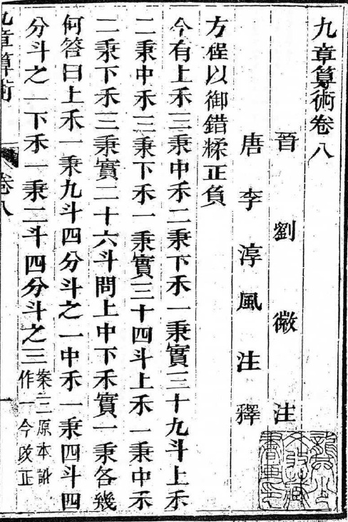
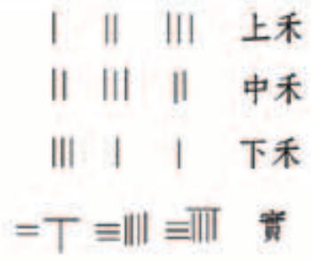
九章算術
置上禾三秉，中禾二秉，下禾一秉，實三十九斗，於右方。中、左禾列如右方。以右行上禾遍乘中行而以直除。又乘其次，亦以直除。然以中行中禾不盡者遍乘左行而以直除。左方下禾不盡者，上為法，下為實。實即下禾之實。求中禾，以法乘中行下實，而除下禾之實。餘如中禾秉數而一，即中禾之實。求上禾亦以法乘右行下實，而除下禾、中禾之實。餘如上禾秉數而一，即上禾之實。實皆如法，各得一斗。
Notes:
黃蓉
漢代
術曰：置上禾三秉，中禾二秉，下禾一秉，實三十九斗，於右方。中、左禾列如右方。以右行上禾遍乘中行而以直除。又乘其次，亦以直除。然以中行中禾不盡者遍乘左行而以直除。左方下禾不盡者，上為法，下為實。實即下禾之實。求中禾，以法乘中行下實，而除下禾之實。餘如中禾秉數而一，即中禾之實。求上禾亦以法乘右行下實，而除下禾、中禾之實。餘如上禾秉數而一，即上禾之實。實皆如法，各得一斗。

Slide 4
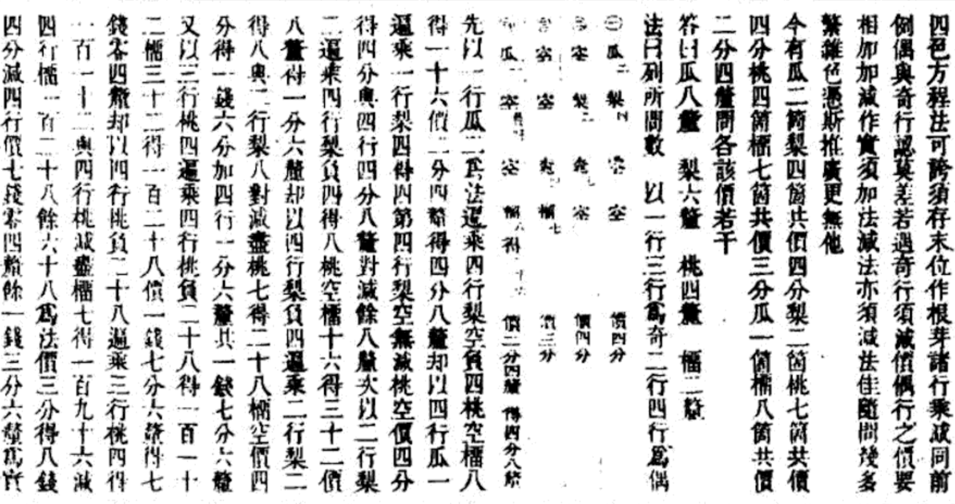
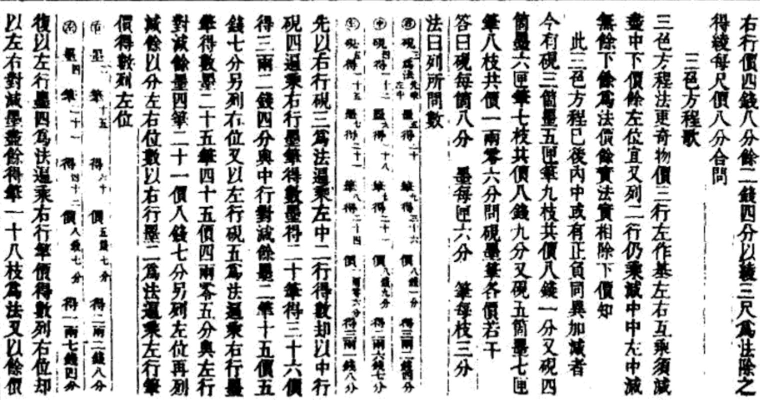
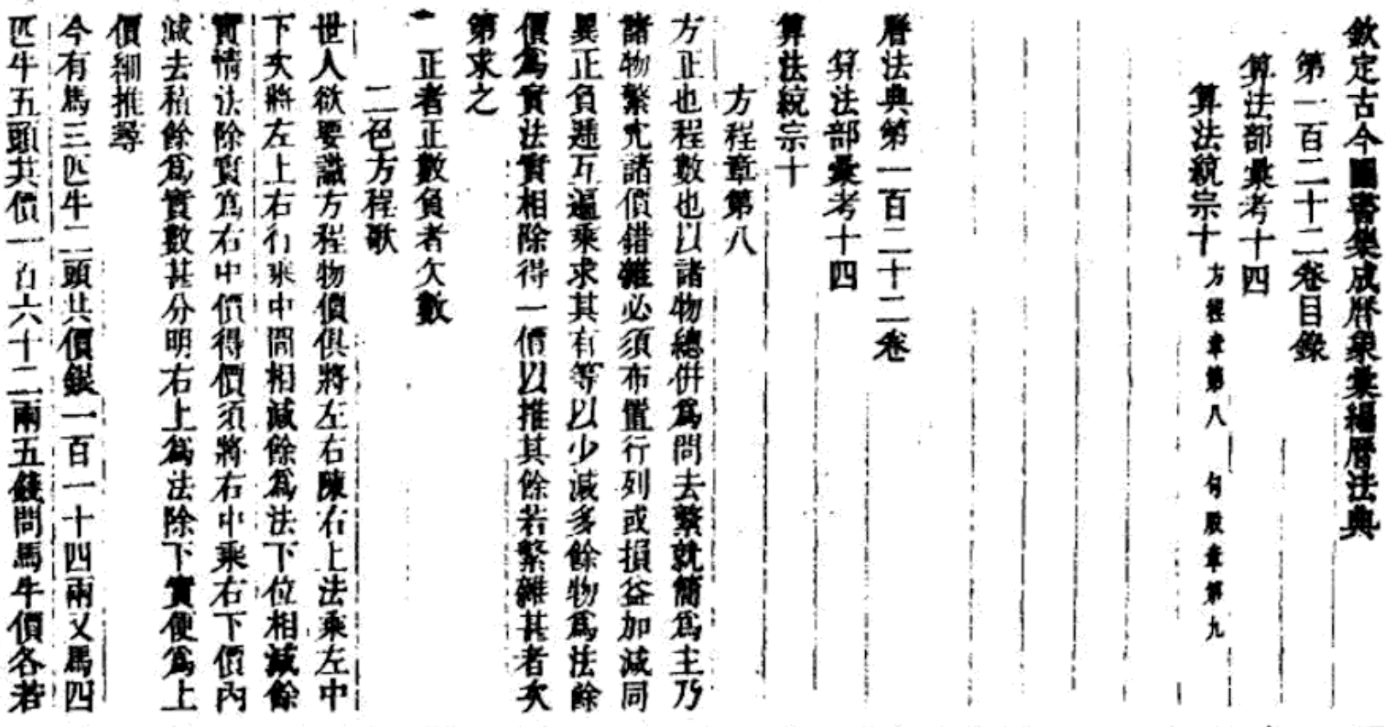
算法統宗

Slide 5
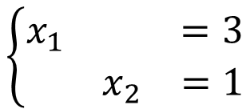
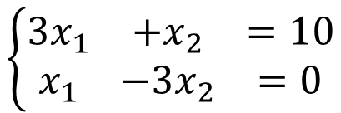
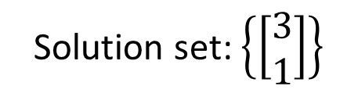
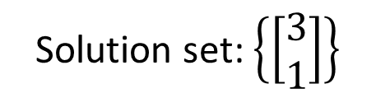
Equivalent
Two systems of linear equations are equivalent if they have exactly the same solution set.
$$\left\{\begin{matrix}\begin{matrix}3x_{1} & +x_{2} & =10\end{matrix} \\ \begin{matrix}x_{1} & −3x_{2} & =0\end{matrix}\end{matrix}\right.$$
$$\left\{\begin{matrix}\begin{matrix}x_{1} & & =3\end{matrix} \\ \begin{matrix} & x_{2} & =1\end{matrix}\end{matrix}\right.$$
Solution set: $\left\{\left[\begin{matrix}3 \\ 1\end{matrix}\right]\right\}$
equivalent
Solution set: $\left\{\left[\begin{matrix}3 \\ 1\end{matrix}\right]\right\}$

Slide 6
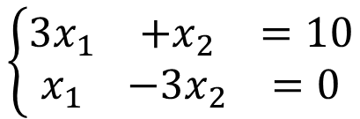
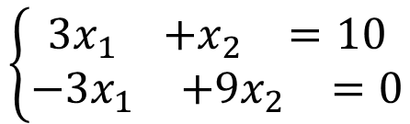
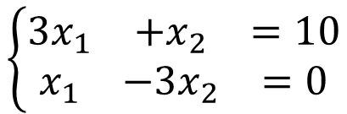
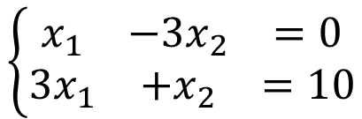
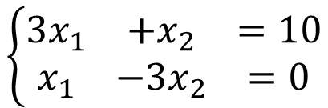
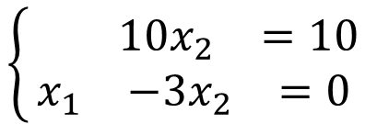
Equivalent
Applying the following three operations on a system of linear equations will produce an equivalent one.
1. Interchange
2. Scaling
3. Row Addition
$$\left\{\begin{matrix}\begin{matrix}3x_{1} & +x_{2} & =10\end{matrix} \\ \begin{matrix}x_{1} & −3x_{2} & =0\end{matrix}\end{matrix}\right.$$
$$\left\{\begin{matrix}\begin{matrix}x_{1} & −3x_{2} & =0\end{matrix} \\ \begin{matrix}3x_{1} & +x_{2} & =10\end{matrix}\end{matrix}\right.$$
$$\left\{\begin{matrix}\begin{matrix}3x_{1} & +x_{2} & =10\end{matrix} \\ \begin{matrix}x_{1} & −3x_{2} & =0\end{matrix}\end{matrix}\right.$$
$$\left\{\begin{matrix}\begin{matrix}3x_{1} & +x_{2} & =10\end{matrix} \\ \begin{matrix}−3x_{1} & +9x_{2} & =0\end{matrix}\end{matrix}\right.$$
X(-3)
$$\left\{\begin{matrix}\begin{matrix}3x_{1} & +x_{2} & =10\end{matrix} \\ \begin{matrix}x_{1} & −3x_{2} & =0\end{matrix}\end{matrix}\right.$$
$$\left\{\begin{matrix}\begin{matrix} & 10x_{2} & =10\end{matrix} \\ \begin{matrix}x_{1} & −3x_{2} & =0\end{matrix}\end{matrix}\right.$$
X(-3)
Notes:
Simple operations defined on a system of linear equations
not change the solution set of the system of linear equations
They are all equivalent.
Used for solving systems of linear equations
Equivalent systems of linear equations: having the same solution set.
An elementary row operation taken on a system of linear equations will result in another equivalent system of linear equations
Elementary row operations for solving systems of linear equations:

Slide 7
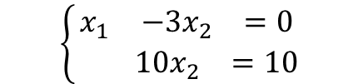
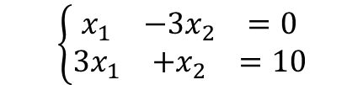
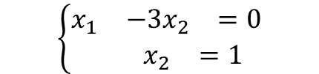

Solving system of linear equation
Two systems of linear equations are equivalent if they have exactly the same solution set.
Strategy:
$$\left\{\begin{matrix}\begin{matrix}x_{1} & −3x_{2} & =0\end{matrix} \\ \begin{matrix}{3x}_{1} & +x_{2} & =10\end{matrix}\end{matrix}\right.$$
$$\left\{\begin{matrix}\begin{matrix}x_{1} & −3x_{2} & =0\end{matrix} \\ \begin{matrix} & 10x_{2} & =10\end{matrix}\end{matrix}\right.$$
$$\left\{\begin{matrix}\begin{matrix}x_{1} & −3x_{2} & =0\end{matrix} \\ \begin{matrix} & x_{2} & =1\end{matrix}\end{matrix}\right.$$
$$\left\{\begin{matrix}\begin{matrix}x_{1} & & =3\end{matrix} \\ \begin{matrix} & x_{2} & =1\end{matrix}\end{matrix}\right.$$
We know how to transform the given system of linear equations into another equivalent system of linear equations.
We do it again and again until the system of linear equation is so simple that we know its answer at a glance.

Slide 8
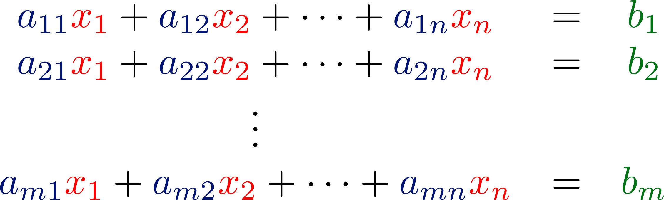

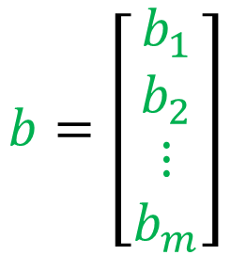
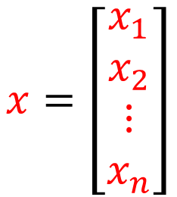
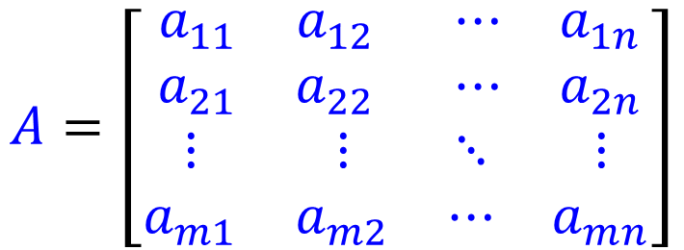
Augmented Matrix
a system of linear equation
$$A=\left[\begin{matrix}\begin{matrix}a_{11} & a_{12} \\ a_{21} & a_{22}\end{matrix} & \begin{matrix}⋯ & a_{1n} \\ ⋯ & a_{2n}\end{matrix} \\ \begin{matrix}⋮ & ⋮ \\ a_{m1} & a_{m2}\end{matrix} & \begin{matrix}⋱ & ⋮ \\ ⋯ & a_{mn}\end{matrix}\end{matrix}\right]$$
$$x=\left[\begin{matrix}\begin{matrix}x_{1} \\ x_{2}\end{matrix} \\ \begin{matrix}⋮ \\ x_{n}\end{matrix}\end{matrix}\right]$$
$$b=\left[\begin{matrix}\begin{matrix}b_{1} \\ b_{2}\end{matrix} \\ \begin{matrix}⋮ \\ b_{m}\end{matrix}\end{matrix}\right]$$
m x n
coefficient matrix

Slide 9
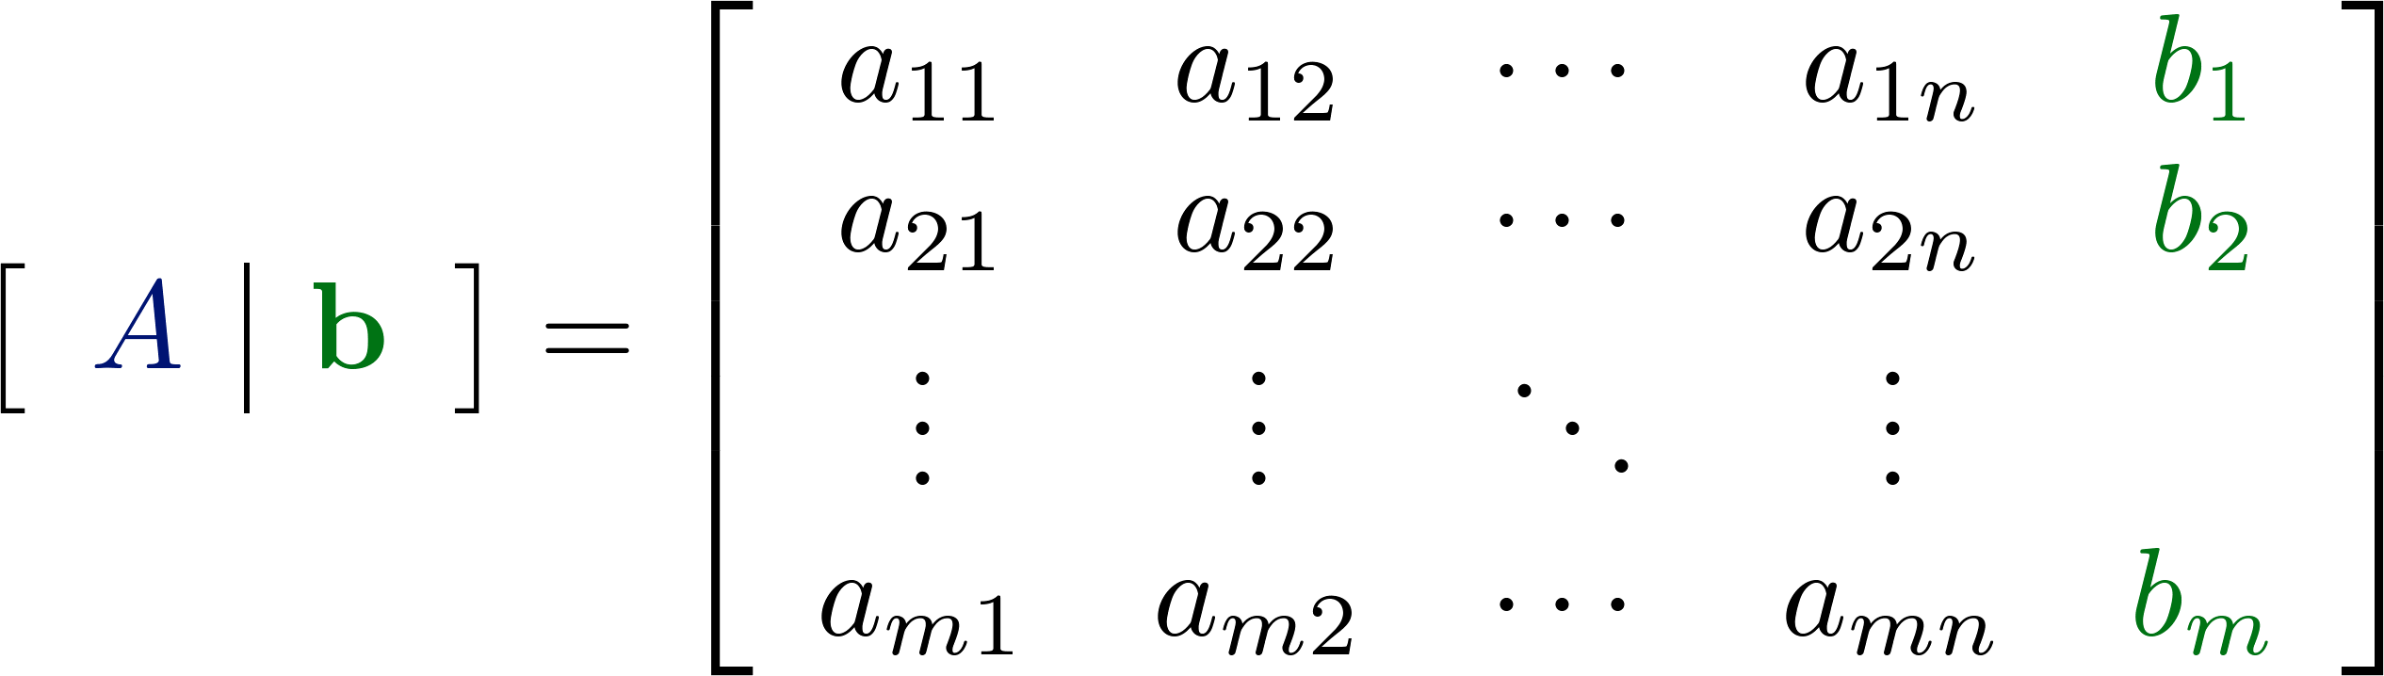
Augmented Matrix
a system of linear equation
m x (n+1)
m x n
m x 1
augmented matrix

Slide 10
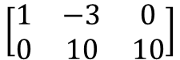
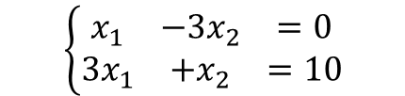
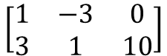
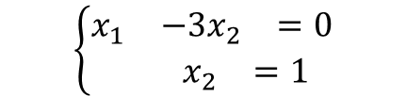

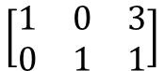
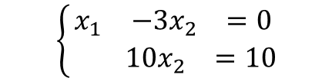
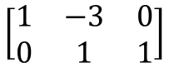
Solving system of linear equation
Two systems of linear equations are equivalent if they have exactly the same solution set.
Strategy of solving:
$$\left\{\begin{matrix}\begin{matrix}x_{1} & −3x_{2} & =0\end{matrix} \\ \begin{matrix}{3x}_{1} & +x_{2} & =10\end{matrix}\end{matrix}\right.$$
$$\left\{\begin{matrix}\begin{matrix}x_{1} & −3x_{2} & =0\end{matrix} \\ \begin{matrix} & 10x_{2} & =10\end{matrix}\end{matrix}\right.$$
$$\left\{\begin{matrix}\begin{matrix}x_{1} & −3x_{2} & =0\end{matrix} \\ \begin{matrix} & x_{2} & =1\end{matrix}\end{matrix}\right.$$
$$\left\{\begin{matrix}\begin{matrix}x_{1} & & =3\end{matrix} \\ \begin{matrix} & x_{2} & =1\end{matrix}\end{matrix}\right.$$
$$\left[\begin{matrix}1 & −3 & 0 \\ 3 & 1 & 10\end{matrix}\right]$$
$$\left[\begin{matrix}1 & −3 & 0 \\ 0 & 10 & 10\end{matrix}\right]$$
$$\left[\begin{matrix}1 & −3 & 0 \\ 0 & 1 & 1\end{matrix}\right]$$
$$\left[\begin{matrix}1 & 0 & 3 \\ 0 & 1 & 1\end{matrix}\right]$$
1. Interchange any two rows of the matrix
2. Multiply every entry of some row by the same nonzero scalar
3. Add a multiple of one row of the matrix to another row
Notes:
有上有下

Slide 11
Solving system of linear equation
A complex system of linear equations
A simple system of linear equations
Ax = b
R′x = b′
equivalent
A’=[ A b ]
A’’
A’’’
……
R=[ R′ b′ ]
reduced row echelon form
1. Interchange any two rows of the matrix
2. Multiply every entry of some row by the same nonzero scalar
3. Add a multiple of one row of the matrix to another row
elementary row operations
Notes:
Every elementary row operations are reversible.
For interchange operation it is obvious, for scaling operation
multiply the inverse of the nonzero constant, and for row addition
operation add the negative multiple of the row to the other row.

Slide 12
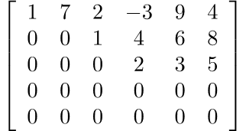
Reduced Row Echelon Form
A system of linear equations is easily solvable if its augmented matrix is in reduced row echelon form
Row Echelon Form
1. Each nonzero row lies above every zero row
2. The leading entries are in echelon form
Notes:
Echelon 【軍】梯次編隊,階層
(Actually condition 3 is implied by 2.)

Slide 13
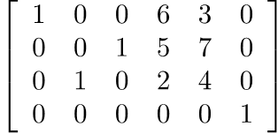
Reduced Row Echelon Form
A system of linear equations is easily solvable if its augmented matrix is in reduced row echelon form
Row Echelon Form
1. Each nonzero row lies above every zero row
2. The leading entries are in echelon form
No zero rows
Notes:
Echelon 【軍】梯次編隊,階層
(Actually condition 3 is implied by 2.)

Slide 14


Reduced Row Echelon Form
A system of linear equations is easily solvable if its augmented matrix is in reduced row echelon form
Reduced Row Echelon Form
1-2 The matrix is in row echelon form
3. The columns containing the leading entries are standard vectors.

Slide 15
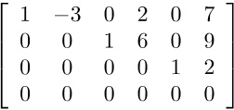
Reduced Row Echelon Form
A system of linear equations is easily solvable if its augmented matrix is in reduced row echelon form
Reduced Row Echelon Form
1-2 The matrix is in row echelon form
3. The columns containing the leading entries are standard vectors.
Notes:
4. If a column contains the leading entry, then all the other entries are 0
5. The leading entries are 1

Slide 16
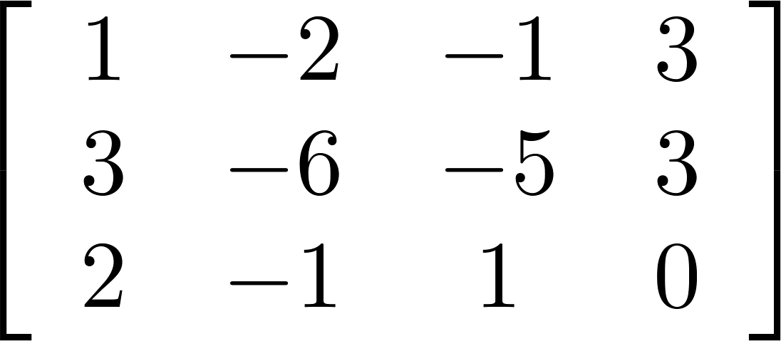
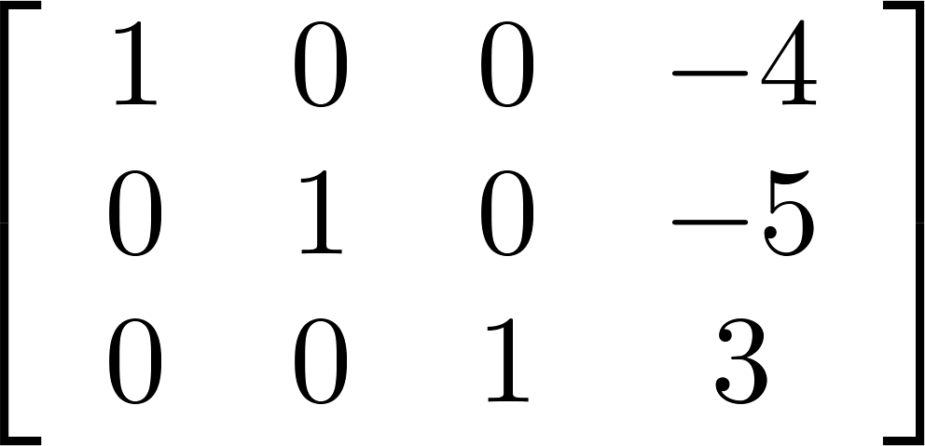
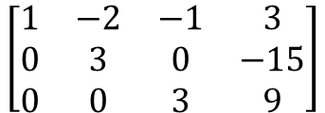
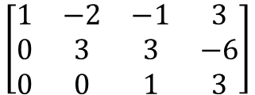
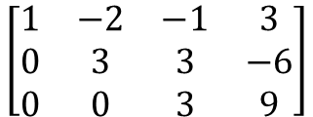
RREF is unique
P577
A matrix can be transformed into multiple REF by row operation, but only one RREF
REF
$$\left[\begin{matrix}\begin{matrix}1 & −2 \\ 0 & 3 \\ 0 & 0\end{matrix} & \begin{matrix}−1 & 3 \\ 3 & −6 \\ 1 & 3\end{matrix}\end{matrix}\right]$$
RREF
REF
$$\left[\begin{matrix}\begin{matrix}1 & −2 \\ 0 & 3 \\ 0 & 0\end{matrix} & \begin{matrix}−1 & 3 \\ 3 & −6 \\ 3 & 9\end{matrix}\end{matrix}\right]$$
REF
$$\left[\begin{matrix}\begin{matrix}1 & −2 \\ 0 & 3 \\ 0 & 0\end{matrix} & \begin{matrix}−1 & 3 \\ 0 & −15 \\ 3 & 9\end{matrix}\end{matrix}\right]$$
Notes:
Can different matrices have the same RREF?

Slide 17
Reduced Row Echelon Form
Pivot 中樞
A
R
Leading Entry
The pivot positions of A are (1,1), (2,3) and (3,4).
The pivot columns of A are 1st, 3rd and 4th columns.

Slide 18
Reduced Row Echelon Form
A system of linear equations is easily solvable if its augmented matrix is in reduced row echelon form
Example 1. Unique Solution
x₁
x₂
x₃
b
If RREF looks like [ I b′ ]
unique solution

Slide 19
Example 2. Infinite Solution
x₁
x₂
x₃
x₄
x₅
b
Free variables
Basic variables
With free variables, there are infinitely many solutions.
Parametric Representation:

Slide 20
Reduced Row Echelon Form
Example 3. No Solution
x₁
x₂
x₃
b
inconsistent
When an augmented matrix contains a row in which the only nonzero entry lies in the last column
The corresponding system of linear equations has no solution (inconsistent).
Notes:
meaning: in the original system of linear equations, there are
mutually contradictory equations.

Slide 21
Reduced Row Echelon Form
http://www.ams.org/notices/201106/rtx110600782p.pdf
http://www.dougbabcock.com/matrix.php
RREF of a matrix is unique.
Gaussian elimination: an algorithm for finding the reduced row echelon form of a matrix.
Original augmented matrix
The reduced row echelon form
A row echelon form
Elementary row operations
Elementary row operations
Please refer to the steps of Gaussian Elimination in the textbook by yourself.
Notes:
MATLAB

Slide 22
Example 1
1
-2
3

Slide 23
Example 1

Slide 24
Example 1
-1

Slide 25
Example 1
-2

Slide 26
Example 1

Slide 27
Example 1

Slide 28
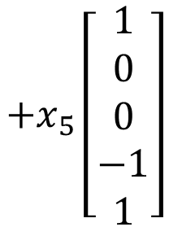
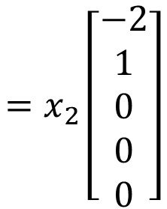
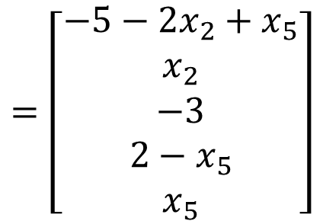
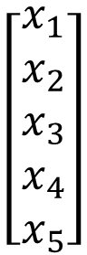
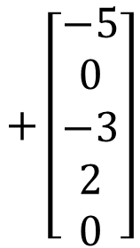
Example 1
x₁
x₂
x₃
x₄
x₅
b
$$\left[\begin{aligned}x_{1} \\ x_{2} \\ x_{3} \\ x_{4} \\ x_{5}\end{aligned}\right]$$
$$=\left[\begin{aligned}−5−2x_{2}+x_{5} \\ x_{2} \\ −3 \\ 2−x_{5} \\ x_{5}\end{aligned}\right]$$
$$=x_{2}\left[\begin{aligned}−2 \\ 1 \\ 0 \\ 0 \\ 0\end{aligned}\right]$$
$$+x_{5}\left[\begin{aligned}1 \\ 0 \\ 0 \\ −1 \\ 1\end{aligned}\right]$$
$$+\left[\begin{aligned}−5 \\ 0 \\ −3 \\ 2 \\ 0\end{aligned}\right]$$

Slide 29
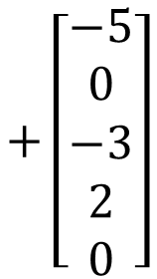
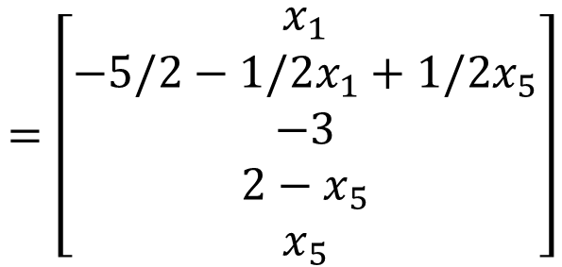
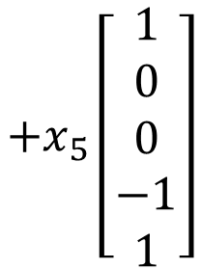
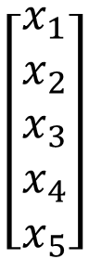
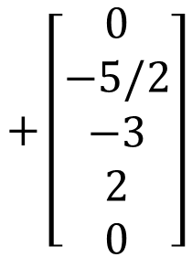
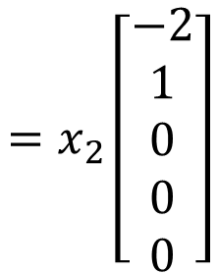
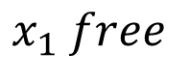





$$\left[\begin{aligned}x_{1} \\ x_{2} \\ x_{3} \\ x_{4} \\ x_{5}\end{aligned}\right]$$
$$=\left[\begin{aligned}−5−2x_{2}+x_{5} \\ x_{2} \\ −3 \\ 2−x_{5} \\ x_{5}\end{aligned}\right]$$
-8
$$+\left[\begin{aligned}−5 \\ 0 \\ −3 \\ 2 \\ 0\end{aligned}\right]$$
$$=x_{2}\left[\begin{aligned}−2 \\ 1 \\ 0 \\ 0 \\ 0\end{aligned}\right]$$
$$+x_{5}\left[\begin{aligned}1 \\ 0 \\ 0 \\ −1 \\ 1\end{aligned}\right]$$
1
1
-1
3
-1
$$x_{1} free$$
$$x_{2}=−\frac{5}{2}−\frac{1}{2}x_{1}+\frac{1}{2}x_{5}$$
-8
$$=\left[\begin{aligned}x_{1} \\ −5/2−1/2x_{1}+1/2x_{5} \\ −3 \\ 2−x_{5} \\ x_{5}\end{aligned}\right]$$
$$\left[\begin{aligned}x_{1} \\ x_{2} \\ x_{3} \\ x_{4} \\ x_{5}\end{aligned}\right]$$
1
$$=x_{1}\left[\begin{aligned}1 \\ −1/2 \\ 0 \\ 0 \\ 0\end{aligned}\right]$$
$$+x_{5}\left[\begin{aligned}0 \\ 1/2 \\ 0 \\ −1 \\ 1\end{aligned}\right]$$
$$+\left[\begin{aligned}0 \\ −5/2 \\ −3 \\ 2 \\ 0\end{aligned}\right]$$
-8
-1
3
-1

Slide 30








Example 2
$$\left[\begin{matrix}\begin{matrix}\begin{matrix}1 & 0 \\ 0 & 1\end{matrix} & \begin{matrix}−3 & 0 \\ 2 & 0\end{matrix} \\ \begin{matrix}0 & 0 \\ 0 & 0\end{matrix} & \begin{matrix}0 & 1 \\ 0 & 0\end{matrix}\end{matrix} \\ \begin{matrix}\begin{matrix}2 & 0 \\ 0 & 2\end{matrix} & \begin{matrix}−6 & 0 \\ 4 & 0\end{matrix} \\ \begin{matrix}0 & 0 \\ 0 & 0\end{matrix} & \begin{matrix}0 & 2 \\ 0 & 0\end{matrix}\end{matrix}\end{matrix}\right]$$
$$\left[\begin{matrix}\begin{matrix}\begin{matrix}1 & 0 \\ 0 & 1\end{matrix} & \begin{matrix}−3 & 0 \\ 2 & 0\end{matrix} \\ \begin{matrix}0 & 0 \\ 0 & 0\end{matrix} & \begin{matrix}0 & 1 \\ 0 & 0\end{matrix}\end{matrix} \\ \begin{matrix}\begin{matrix}0 & 0 \\ 0 & 0\end{matrix} & \begin{matrix}0 & 0 \\ 0 & 0\end{matrix} \\ \begin{matrix}0 & 0 \\ 0 & 0\end{matrix} & \begin{matrix}0 & 0 \\ 0 & 0\end{matrix}\end{matrix}\end{matrix}\right]$$
Find the RREF of
$$R=\left[\begin{matrix}\begin{matrix}1 & 0 \\ 0 & 1\end{matrix} & \begin{matrix}−3 & 0 \\ 2 & 0\end{matrix} \\ \begin{matrix}0 & 0 \\ 0 & 0\end{matrix} & \begin{matrix}0 & 1 \\ 0 & 0\end{matrix}\end{matrix}\right]$$
$$R$$
$$R$$
$$×\left(−2\right)$$
$$2R$$
$$O$$

Slide 31







Example 3
$$R=\left[\begin{matrix}\begin{matrix}1 & 0 \\ 0 & 1\end{matrix} & \begin{matrix}−3 & 0 \\ 2 & 0\end{matrix} \\ \begin{matrix}0 & 0 \\ 0 & 0\end{matrix} & \begin{matrix}0 & 1 \\ 0 & 0\end{matrix}\end{matrix}\right]$$
$$\left[\begin{matrix}R & 2R \\ R & −R\end{matrix}\right]$$
Find the RREF of
$$\left[\begin{matrix}\begin{matrix}\begin{matrix}1 & 0 \\ 0 & 1\end{matrix} & \begin{matrix}−3 & 0 \\ 2 & 0\end{matrix} \\ \begin{matrix}0 & 0 \\ 0 & 0\end{matrix} & \begin{matrix}0 & 1 \\ 0 & 0\end{matrix}\end{matrix} & \begin{matrix}\begin{matrix}0 & 0 \\ 0 & 0\end{matrix} & \begin{matrix}0 & 0 \\ 0 & 0\end{matrix} \\ \begin{matrix}0 & 0 \\ 0 & 0\end{matrix} & \begin{matrix}0 & 0 \\ 0 & 0\end{matrix}\end{matrix} \\ \begin{matrix}\begin{matrix}0 & 0 \\ 0 & 0\end{matrix} & \begin{matrix}0 & 0 \\ 0 & 0\end{matrix} \\ \begin{matrix}0 & 0 \\ 0 & 0\end{matrix} & \begin{matrix}0 & 0 \\ 0 & 0\end{matrix}\end{matrix} & \begin{matrix}\begin{matrix}1 & 0 \\ 0 & 1\end{matrix} & \begin{matrix}−3 & 0 \\ 2 & 0\end{matrix} \\ \begin{matrix}0 & 0 \\ 0 & 0\end{matrix} & \begin{matrix}0 & 1 \\ 0 & 0\end{matrix}\end{matrix}\end{matrix}\right]$$
$$\left[\begin{matrix}R & 2R \\ R & −R\end{matrix}\right]$$
$$\left[\begin{matrix}R & 2R \\ O & −3R\end{matrix}\right]$$
$$\left[\begin{matrix}R & O \\ O & −3R\end{matrix}\right]$$
$$\left[\begin{matrix}R & O \\ O & R\end{matrix}\right]$$
Notes:
Linear equation
System of linear equations
Solution
Solution set
Consistent and inconsistent system of linear equations
Equivalent systems of linear equations
Coefficient matrix and augmented matrix of systems of linear equations.
Basic variables and free variables
Elementary row operations
Row echelon form and reduced row echelon form.

Slide 32

Checking Independence
Linear independent or not?
A set of n vectors {a₁, a₂, …, a_{n}} is linear dependent
Given a vector set, {a₁, a₂, …, a_{n}}, if there exists any a_{i} that is a linear combination of other vectors
matrix A
Given a vector set, {a₁, a₂, …, a_{n}}, there exists scalars x₁, x₂, …, x_{n}, that are not all zero, such that x₁a₁ + x₂a₂ + ☹ + x_{n}a_{n} = 0.
vector x
$Ax=0$ have non-zero solution

Slide 33




Checking Independence
Linear independent or not?
A
$$\left[\begin{matrix}\begin{matrix}x_{1} \\ x_{2}\end{matrix} \\ \begin{matrix}x_{3} \\ x_{4}\end{matrix}\end{matrix}\right]$$
$$\left[\begin{matrix}\begin{matrix}1 & 1 \\ 2 & 0 \\ 1 & 1\end{matrix} & \begin{matrix}1 & 1 \\ 4 & 2 \\ 1 & 3\end{matrix}\end{matrix}\right]$$
$$=\left[\begin{matrix}0 \\ 0 \\ 0\end{matrix}\right]$$
$Ax=0$ have non-zero solution or not
x₁
x₂
x₃
x₄
x₁
x₂
x₃
x₄
RREF
Notes:
存在非0
均为0

Slide 34












Checking Independence
x₁
x₂
x₃
x₄
x₁
x₂
x₃
x₄
RREF
$$x_{1}+2x_{3}=0$$
$$x_{1}=−2x_{3}$$
$$x_{2}−x_{3}=0$$
$$x_{2}=x_{3}$$
$$x_{3} is free$$
$$x_{4}=0$$
$$x_{4}=0$$
$$\left[\begin{matrix}\begin{matrix}x_{1} \\ x_{2}\end{matrix} \\ \begin{matrix}x_{3} \\ x_{4}\end{matrix}\end{matrix}\right]$$
$$=\left[\begin{matrix}\begin{matrix}−2x_{3} \\ x_{3}\end{matrix} \\ \begin{matrix}x_{3} \\ 0\end{matrix}\end{matrix}\right]$$
$$x_{3}\left[\begin{matrix}\begin{matrix}−2 \\ 1\end{matrix} \\ \begin{matrix}1 \\ 0\end{matrix}\end{matrix}\right]$$
setting x₃ = 1
$$\left[\begin{matrix}\begin{matrix}x_{1} \\ x_{2}\end{matrix} \\ \begin{matrix}x_{3} \\ x_{4}\end{matrix}\end{matrix}\right]=\left[\begin{matrix}\begin{matrix}−2 \\ 1\end{matrix} \\ \begin{matrix}1 \\ 0\end{matrix}\end{matrix}\right]$$
$$=$$

